Slide 1
Java and XSLT Mapping
Mumbai, Aug-2019, Nikhil

Slide 2
Table of contents
Java Mapping
1
XSLT Mapping
2

Slide 3
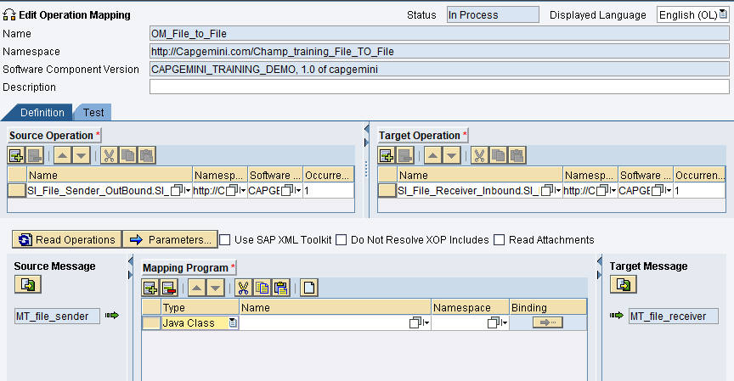
1. Java Mapping
Java Mappings are used in cases where the desired functionality cannot be achieved by using Graphical mapping tools and Parameterized mapping. You can write your own Java Class, import it and to the Operation Mapping.

Slide 4
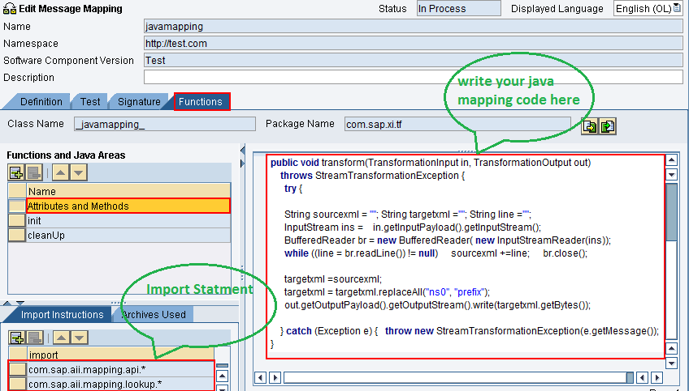
But with SAP PO 7.5, we can also write Java Mapping code directly inside the Message mapping.

Slide 5
Demonstration:
We will create a simple Java Mapping to prefix a line to our payload.
Below is the code we need to implement.
package com.map;
import java.io.*;
import com.sap.aii.mapping.api.*;
public class Test_JavaMapping extends AbstractTransformation {
@Override
public void transform(TransformationInput transformationInput, TransformationOutput transformationOutput) throws StreamTransformationException {
try {
InputStream inputstream = transformationInput.getInputPayload().getInputStream();
OutputStream outputstream = transformationOutput.getOutputPayload().getOutputStream();
// Copy Input content to Output content
byte[] b = new byte[inputstream.available()];
inputstream.read(b);
outputstream.write("Prefixing this line to input. Test_JavaMapping. \r\n".getBytes());
outputstream.write(b);
} catch (Exception exception) {
getTrace().addDebugMessage(exception.getMessage());
throw new StreamTransformationException(exception.toString());
}
}
}

Slide 6
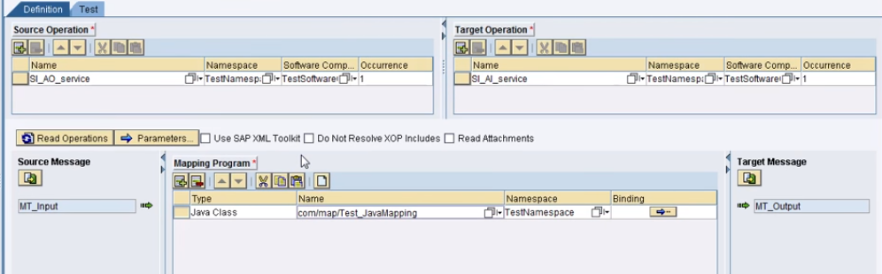
We write the above Java code in NWDS, and import the Java class in SAP PI.
In Operation mapping we select the Java class.

Slide 7
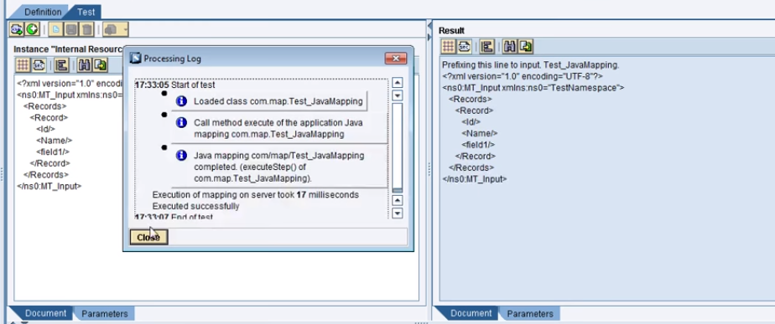
We test it in Operation Mapping.

Slide 8
2. XSLT Mapping
XSLT stands for Extensible Style sheet Language Transformation. It is an XML based language for transforming XML documents on the basis of set of well-defined rules. Using XSLT we can transform XML to XML, Text, HTML/XHTML, PDF etc.
When to use XSLT mapping?
Sometimes it is difficult to produce desired output using graphical mapping. For example text/html output, sorting or grouping of records etc. A few situations where XSLT mapping fits well are:
When the required output is other than XML like text, html or xhtml
When data is to be filtered based on certain fields
When data is to be sorted based on certain field
When data is to be grouped based on certain field

Slide 9
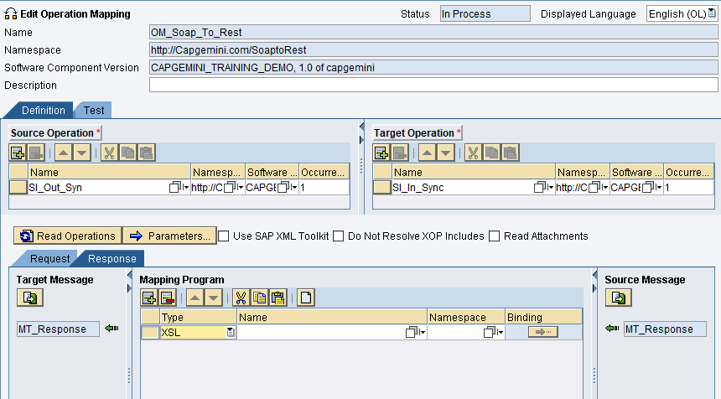
We can import our XSL file in SAP PO, and add it to the Operation Mapping as shown below.

Slide 10
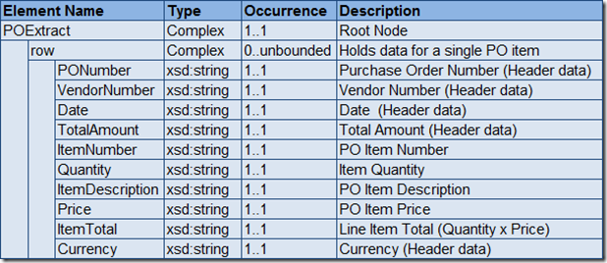
Demonstration:
Source XML Structure

Slide 11
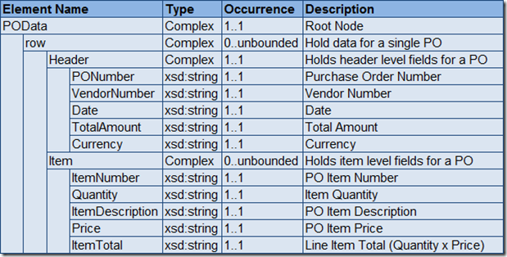
Demonstration:
Target XML Structure

Slide 12
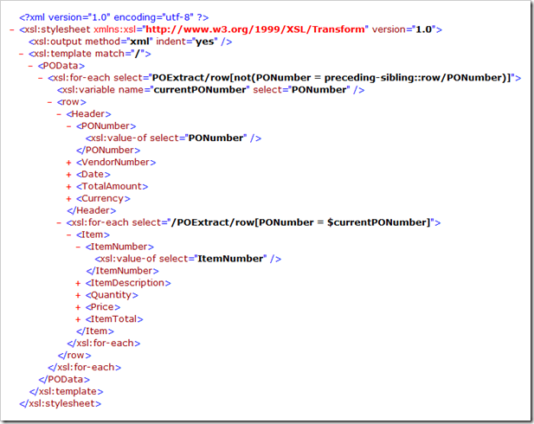
Let us understand the XSLT Mapping to perform the desired functionality.

Slide 13
<xsl:stylesheet> tag indicates that this is an XSL document
<xsl:template> tag is used to match “/” i.e. entire source document. So the rules within <xsl:template> and </xsl:template> will be used produce the target XML.
We store the current PO Number in a variable called currentPONumber using
<xsl:variable> tag. <xsl:for-each> checks whether the current and previous PO numbers differ. Only if the numbers differ, the elements will be produced at the output. Thus, the Header data will be produced at the output only once for each PO number.
We have another <xsl:for-each> loop within the existing <xsl:for-each>. This is used to produce item level fields at the output. The <xsl:for-each> tag compares the PO number with the PO number stored in the variable currentPONumber. Only if the values match, the underlying elements will be produced at the output. Thus, item level details will be produced under the current PO row node only if they belong to the current PO.
<xsl:value-of> tags are used to move individual XML field values to the target structure.

